Slide 1
Planning for Learning in the Library

Slide 2
How the students engage with literature and information during your library lessons is a decision between yourself and the classroom teacher, based on both the library and school curricula.
Think about . . .
learning needs of the children
your school context
your personal skills and knowledge

Slide 3
Consider the following . . .

Slide 4
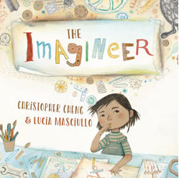
Information Processing Skills
Literature
Learning Area Content:
English
EAL
History
Science
Geography

Slide 5
Will this work be part of the class programme or is it a stand-alone learning opportunity?
Be creative…what could learning look like? This is where your skill and passion should shine!
Which information processing skills will you focus on?
Are they achievable for your students?
What do you want the students to learn?
What strengths and talents can you bring to the learning experience?
Is there a specific text that would support this concept/outcome?
What other books might you include?

Slide 6
OUTCOME
INFORMATION SKILLS
What is the student expected to learn?
How do these skills support the curriculum?
ASSESSMENT
COLLABORATION
How will student learning be monitored? What are your success criteria?
What are the different roles of the class teacher and the teacher librarian in the learning?

Slide 7
Information Processing Skills
are the ways we find, use and interact with the information we need.

Slide 8
Connect & Wonder
What do I already know?
What do I need to know?
This step may involve:
Forming questions: what, when, how, why, where
Deciding on focus
Constructing a list of key words in relation to the topic.
Discussing the topic, brainstorming and clarifying known information.

Slide 9
Discover & Learn
Where can I find the information required?
Is the information selected valid and relevant?
This step may involve:
identifying the range of information available (print, digital, human, organisations)
finding information and assessing the reliability (eg evaluating websites)
learning to recognise which information relates to the topic and is credible
recording resources used (bibliographies)

Slide 10
Create
Who is my intended audience?
What tools could I use?
This step may involve:
introducing and exploring new digital programs and print options for presenting information
copyright issues if music and images are included in a presentation
matching audience with presentation formats (eg parents – school website)
asking for feedback prior to publishing

Slide 11
Review & Redo
What did I do well?
What changes would I make if I could do this again?
This step may involve:
class review and reflection on presentations
discussing group performance for collaborative tasks
editing and republishing if required/desired

Slide 12
Share & Act
How will I use what I have learned?
How can we use what we have learned to bring positive change to a situation?
This step may involve:
Discussing how the issue might change and what it could look like in the future.
Doing something with or about what has been learned

Slide 13
Lesson Examples

Slide 15
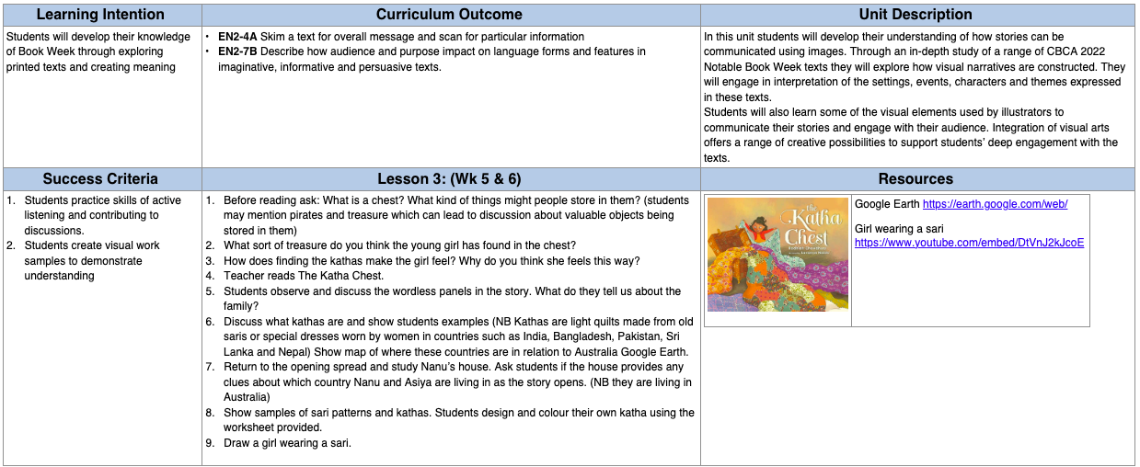
Information Processing Skills for this lesson are Connect & Wonder, and Create

Slide 16
Lesson Plan Template Example

Slide 17
UNIT TITLE: TEACHER: GRADE:
LEARNING INTENTION | LESSON | RESOURCES
CURRICULUM AREA | ASSESSMENT

Slide 18
Now it’s your turn . . .
Please complete the survey about today’s sessions by following this link https://www.surveymonkey.com/r/8RC87HS

